Slide 1
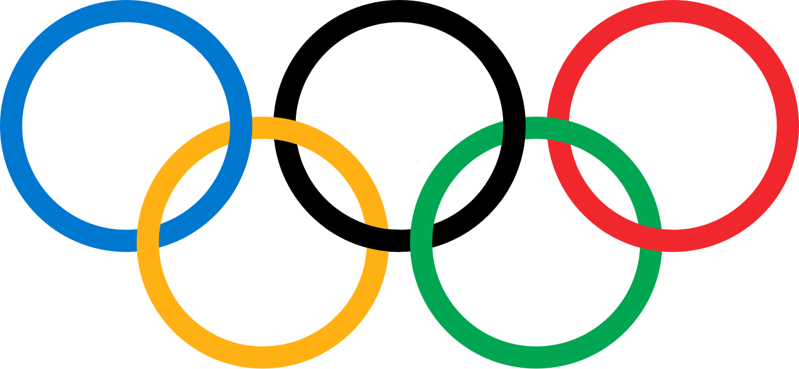
olympic

Slide 2

Sports AND ITS BENEFITS

Slide 3

AMITY INTERNATION BUSINESS SCHOOL 2012 -2015
BY :
SUNIL Kr. Ahirwar
BBA-IB ‘’AIBSS’’
MR.ARCHISMAN SEN

Slide 4

AMITY UNIVERSITY
SPORTS
Sport[or sports] is from of
Usually competitive physical activity
Which ,through casual or organized
Participants , and in some cases , spectators. Hundreds of sports exist , from those requiring only two participants , either in teams or competing as individuals.

Slide 5
amity university
HISTROY
Sports comes from the old French desports meanings ‘’ leisure ‘.’
Chines engaged in sporting activites early in 2000 BC .
Gymnastics appears to have been a popular sports in China ‘s ancient past .
Sports have been increasingly organized and regulated from the time of the anicents Olympics up to presents century .

Slide 6
amity university
DEFINITION
BE IN NO WAY HARMFUL TO ANY LIVINFG CREATURE
HAVE AN ELEMENTS OF COMPETITION
BE not contain any jealousy or grudges among people
be played fairly without any use of unfair means

Slide 7
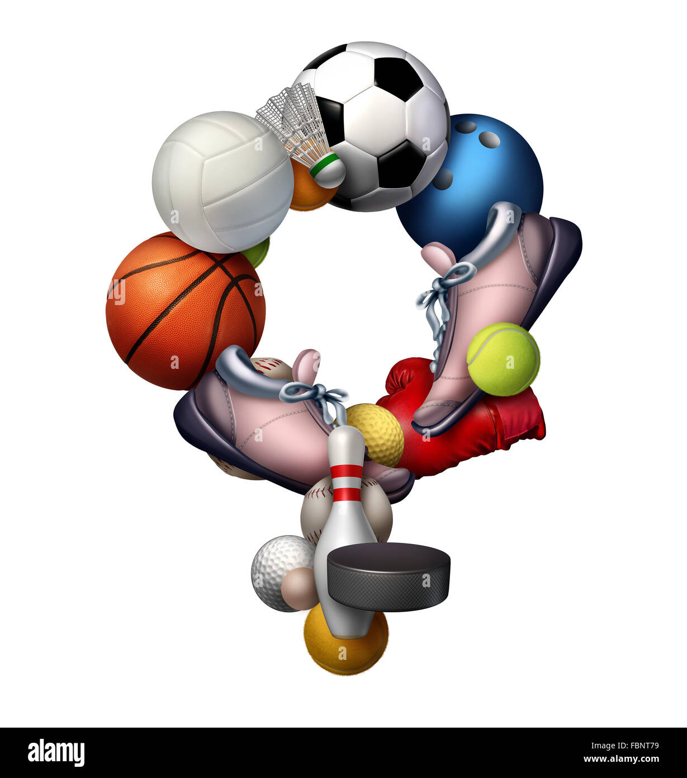
physical benefits
Amity university
Increased strength and stamina
Better body shape increased agility
They help burn calories and shed those extra pounds
Reduce several health risk
Improves yours personality

Slide 8
Amity university
psychological benefits
They encourage you to give your best every time
skill Sports boost confidence
They build leadership and team
Develop your social skills, makes you more interactive .

Slide 9
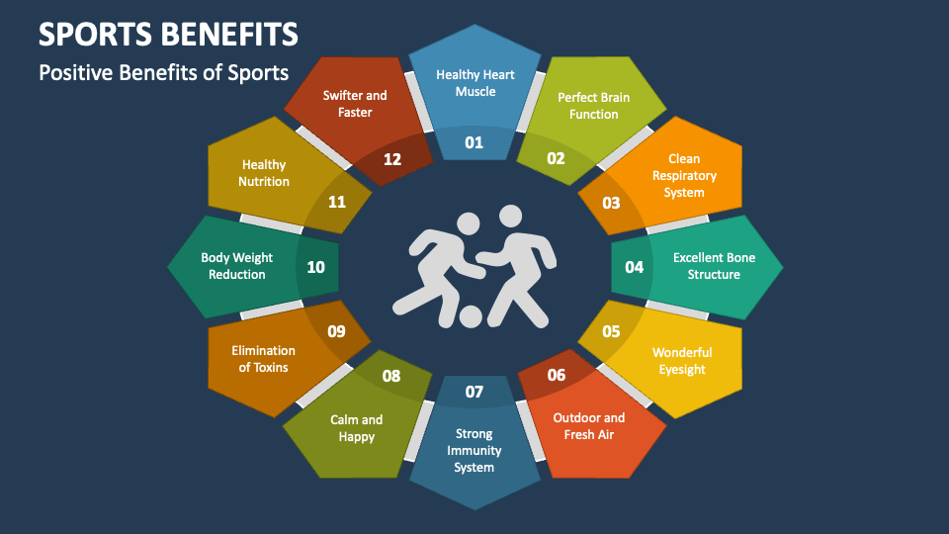
amity university

Slide 10
amity university
Mental health benefits
:reduced anxiety and depression
:stress reliever ,makes you happy
: promotes positives mood
: increase of self esteem
: avoids distraction
: better sleep pattern

Slide 11
AMITY UNIVERSITY
SPORTS , UNITY AND PEACE
SPORTS BRING DIFFERENT NATION TOGETHER
SPORTS IS SYMBOL OF PEACE
SPORTS UNITES PEOPLE , UNITES CNATION
SPORTS CREATES BONDING , CREATES GOOD REALTIONSHIP BETWEEN DIFFERENTS PEOPLE FROM DIFFERENT RELIGION

Slide 12
AMITY UNIVERSITY
SPORTS INVOLVES PHYSICAL ACTIVITY
CAPABLE OF ACHIEVING A RESULT
RULES & REGULATION OF SPORTS
DIFFERENTS TYPES OF SPORTS
FAIR COMPETITION

Slide 13
SPORTSMANSHIPS
SPORTSMANSHIP IS AN ATTITUDE THAT STRIVES FOR FAIR PLAY , COURTESY TOWARD TEAMMATES AND OPPONENTS , ETHICAL BEHAVIOUR AND INTEGRITY , AND GRACE IN VICTORY OF DEFEAT .
SPORTS EXPRESSES AN ASPIRATION OR ETHOS THAT THE ACTIVITY WILL BE ENJOYED FOR ITS OWN SAKE . IT’S “ NOT THAT YOU WON OR LOST BUT HOW YOU PLAYED THE GAME , AND THE MOST IMPORTANT THING ….. IS NOT WINNINGS BUT TAKINGH PARTS ‘’

Slide 14
THANK YOU

